Slide 1
Visualizing Country Music
Exploring Country Music’s Changes since its “Golden Era” Using the Spotify API

Slide 2
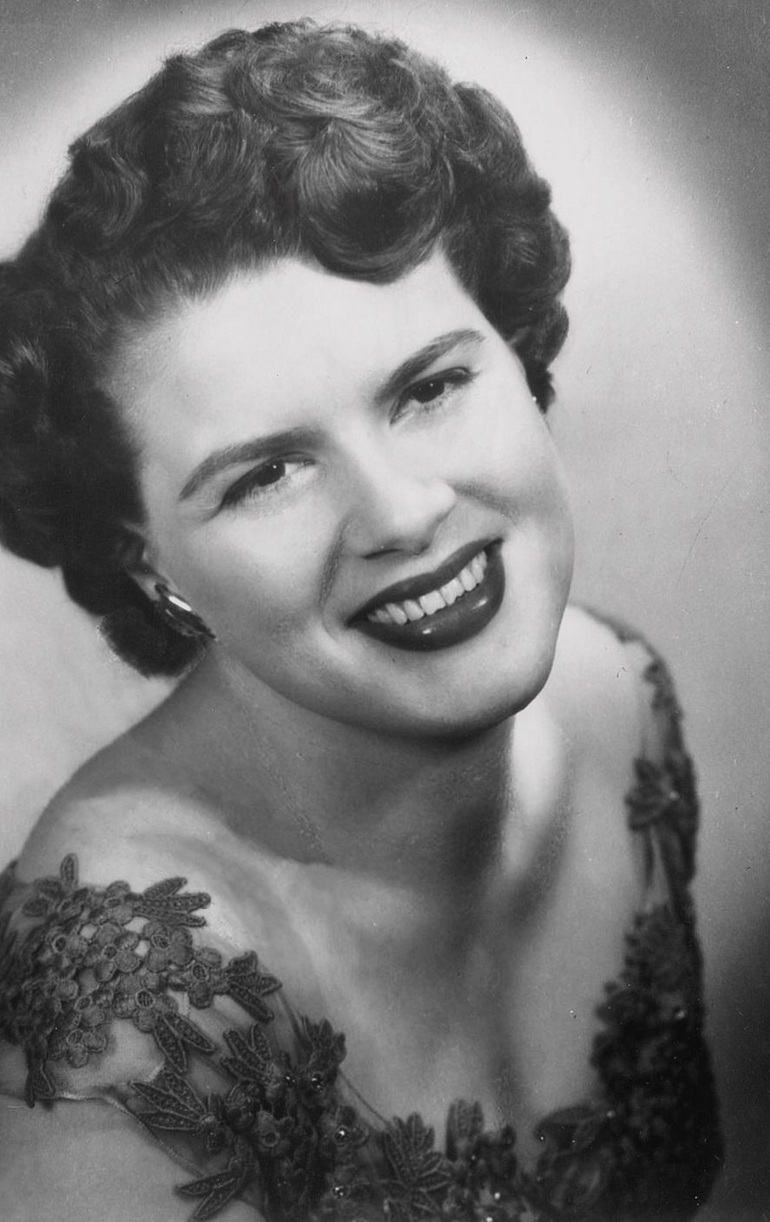
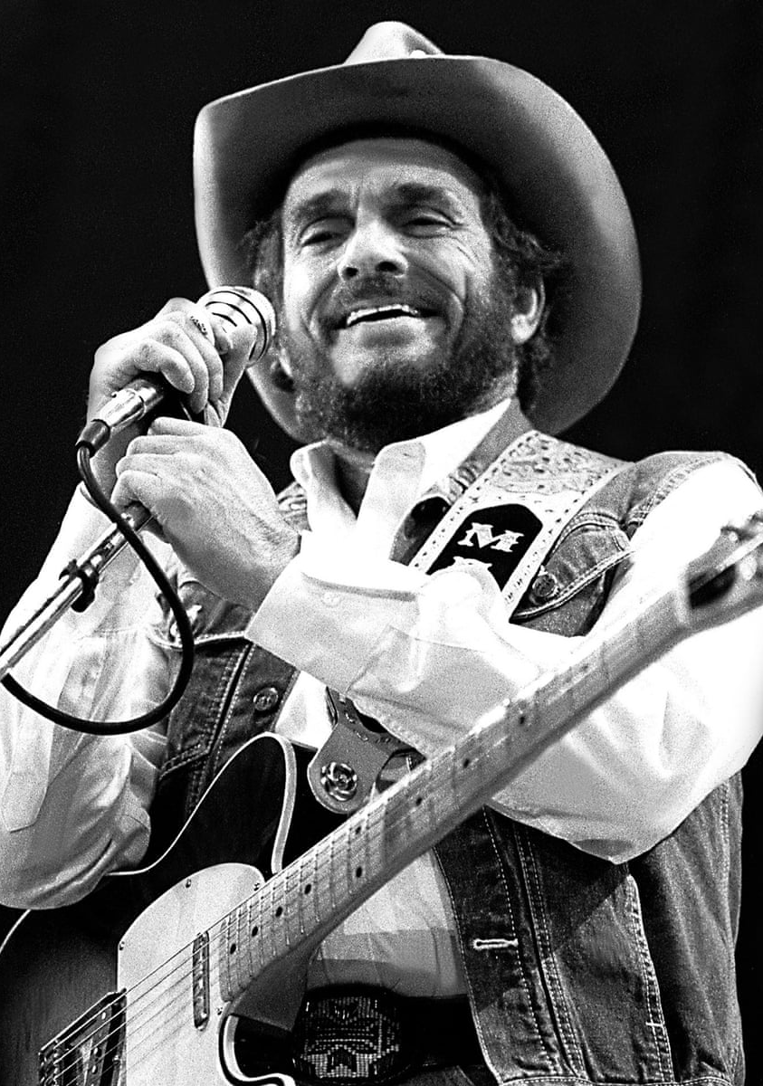
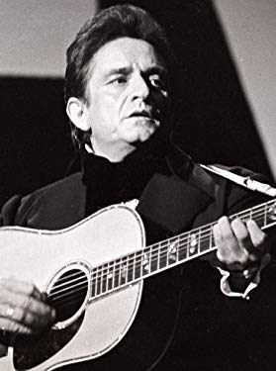
The Question:
How has country music progressed since its heyday to now?

Slide 3

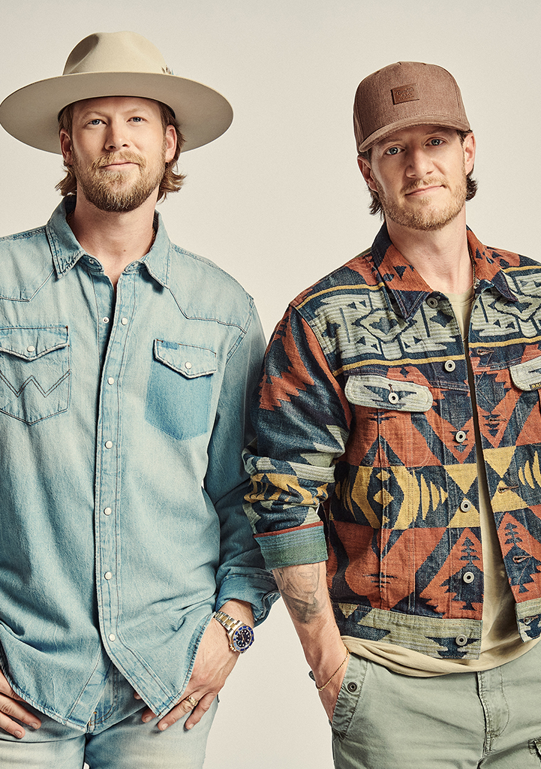

The Question
How have pop and country music's trajectories correlated/diverted?

Slide 4

The Method
Through the usage of Spotify’s API and Python, information about every song, artist, playlist, and more can be accessed.

Slide 5
The Metrics
Acousticness: A measure from 0 to 1 determining presence and magnitude of acoustic elements
Danceability: Indicator from 0 to 1 determining how suitable a track is for dancing based on a combination of musical elements including tempo, rhythm stability, beat strength, and overall regularity.
Energy: Measure from 0 to 1 range describing perceptual intensity and interactivity of a song
Loudness: Decibel level averaged through entire track and usually between -60 and 0 db
Speechiness: Detects the presence of spoken words in a track with 0 being few words and 1 being wordier (rap, audiobooks, etc.)
Tempo: Estimated tempo of a track in beats-per-minute (bpm)
Valence: Musical positivity conveyed by a track from 0 to 1

Slide 6
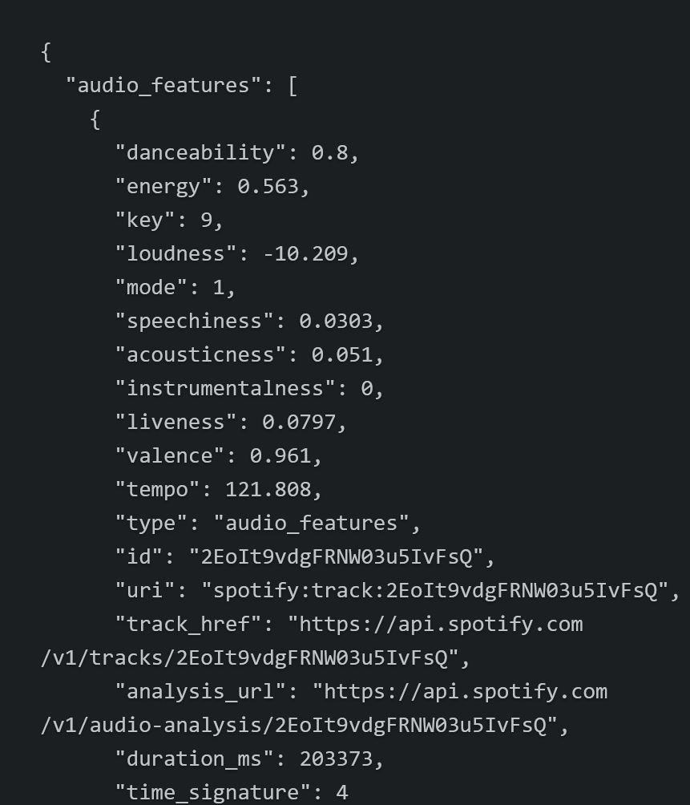

Slide 7
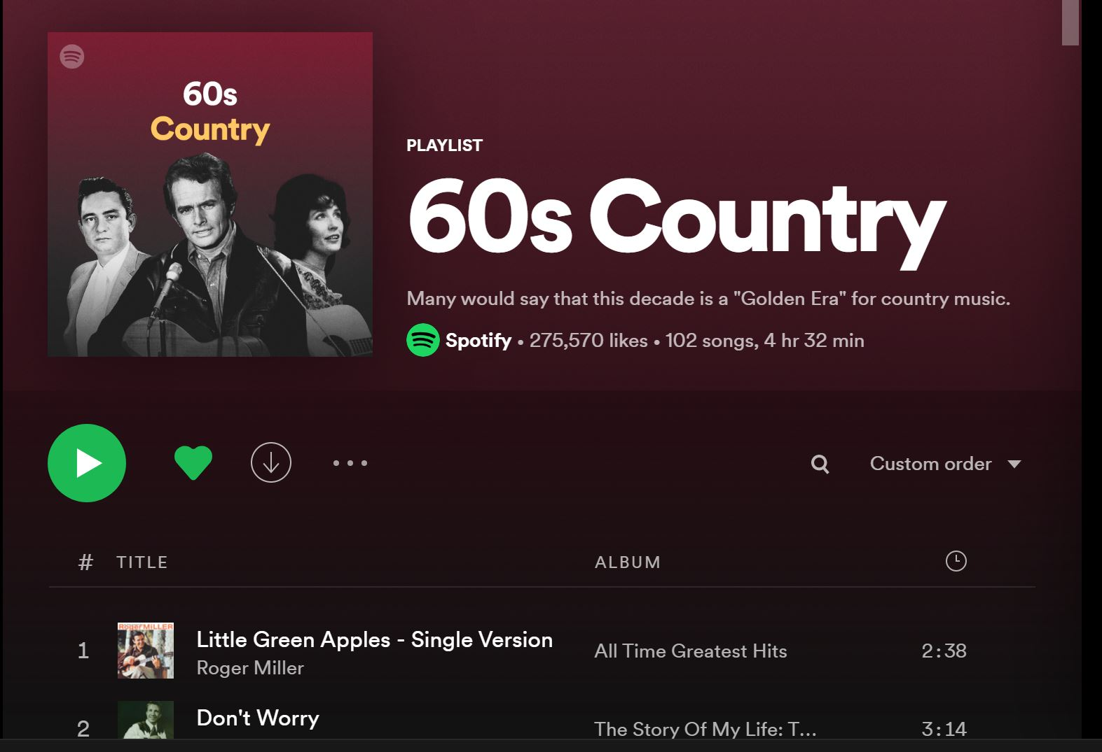
The Data
Spotify-created playlists
Dave’s Music Database: Rankings are figured by combining sales figures, chart data, radio airplay, video airplay, streaming figures, awards, and appearances on best-of lists.
Billboard year-end charts

Slide 8
The Dashboard
https://app.powerbi.com/groups/me/reports/e550b1f1-b461-44c1-9b00-39f2cc505563/ReportSection

Slide 9
Conclusions
The danceabillity metric behaved very differently between country and pop, with it being more concentrated around the median with a gradual tapering off for country and more variability with gradual increasing in prevalence for pop.
Pop music rewarded highly energetic music with strong concentration around the mean for the energy variable before it becomes less prominent as the new millennium progresses. Country music suddenly becomes energetic in the 90's and remains at a relatively consistent level.
The greatest musical difference between pop and country found across all variables was for valence during the 90's.

Slide 10
Sources
https://wallpaperaccess.com/full/1373271.jpg
https://towardsdatascience.com/visualizing-spotify-songs-with-python-an-exploratory-data-analysis-fc3fae3c2c09
https://developer.spotify.com/
https://spotipy.readthedocs.io/en/2.19.0/
https://www.billboard.com/charts/year-end/2020/hot-country-songs/
https://medium.com/web-mining-is688-spring-2021/preliminary-data-analysis-on-spotify-data-using-api-a84bb0aae00c

